Slide 1
Gen-Ai based Data Profiling
Team Name : Error_Human_Not_Found

Slide 2
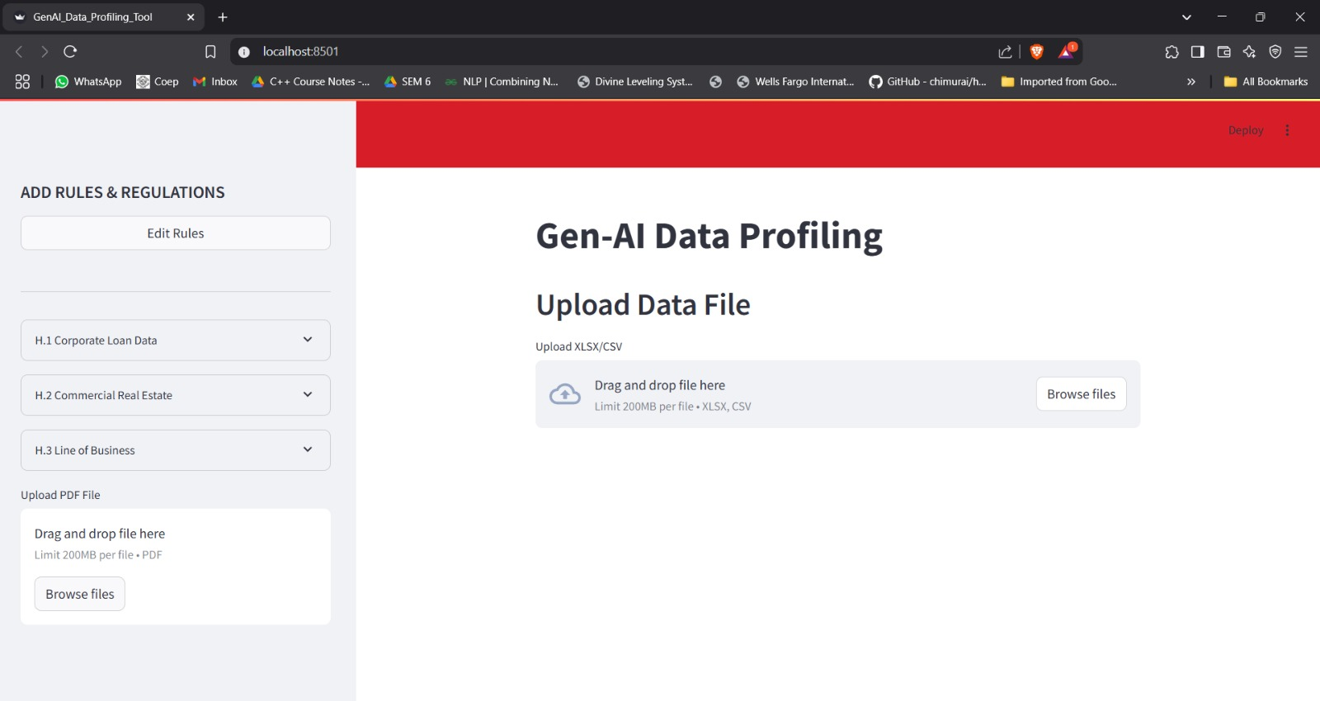
Table of Contents
Introduction
Inspiration
What it does?
Architecture
How we built it and Tech Stack
Challenges we faced
Demo
Team

Slide 3
Introduction
Our project, Gen AI-based data profiling leverages generative AI to automate and enhance the process of analyzing, understanding, and improving data quality.
Purpose :
Automated Rule Discovery - Uses AI to extract and refine the rules and constraints from documents (e.g., PDFs) and reduces manual effort in defining data validation rules which will be later used for data profiling.
Context-Aware Profiling - Customizes profiling results based on business requirements and schedule provided.
Scalable Profiling – Able to include changes in data sources without extensive reconfiguration.

Slide 4
Inspiration
In the banking domain, ensuring accurate and rule-compliant customer data profiling is critical. Traditionally, this process requires significant manual effort to categorize and validate data while adhering to strict regulatory and business rules. However, manual checks are time-consuming, error-prone, and difficult to scale.
Our goal with Gen AI-based data profiling is to explore whether AI can effectively interpret and enforce complex rules while improving efficiency and accuracy. By leveraging AI, we aim to automate data categorization, reduce human intervention, and enhance compliance—ultimately delivering more reliable results.

Slide 5
Proposed Solution
The solution follows a structured workflow to ensure seamless data profiling:
Rule Extraction
The client provides a PDF document containing business and regulatory rules.
We extract these rules from the PDF and convert them into a structured format.
Refine the rules to make them easier to understand and interpret.
Rule Storage
The extracted rules are stored in a structured database, ensuring easy retrieval and scalability.
These rules define the criteria that customer data must adhere to for compliance.
Data Ingestion
The client submits a dataset that needs to be profiled.
This dataset contains customer information, transactions, or other financial data according to the schedule.
Rule Application
The stored rules are applied to the client’s dataset.
The system checks whether each data record complies with the extracted rules.
Anomaly Detection
The system identifies and flags records that do not adhere to the given rules.

Slide 6




Architecture
Rules
Extractor
(Gemini)
Federal Reserve Rules
(pdf)
Pre
Processing
Refined
Rules
Rules Database
AI-based Rule checking (Gemini)
Transaction Data (xlsx/csv)
Output Report: <Record | Field | Rule | Remediation>

Slide 7
How We Built It Tech Stack
LLM’s: Gemini Flash 2.0
Data Processing: Python libraries ( Pandas, Numpy, json )
Visualization and Interactivity: Streamlit
Frontend: Streamlit
Backend: Python
Database: Excel, JSON, Csv
Other: Gemini

Slide 8
Challenges we Faced
Inaccurate Rule Extraction
In the initial stages, the AI-based rule extraction process was not entirely accurate.
Some extracted rules were incomplete or misinterpreted, leading to discrepancies in data categorization.
This required manual validation and corrections, increasing the effort needed to refine the AI model.
Lack of Ready-to-Use Datasets
A major challenge was the absence of real-world datasets for testing the extracted rules.
Client datasets were either unavailable or too sensitive to use directly due to privacy and compliance concerns.
To address this, we implemented Synthetic Dataset Generation, creating test datasets that mimicked real-world scenarios while maintaining privacy and compliance considerations.
Need for Manual Verification
Despite AI-driven automation, manual validation was necessary to ensure that the dataset adhered to the extracted rules.
AI misinterpretations or edge cases occasionally led to false positives or negatives in anomaly detection.

Slide 9
Team Members
Abhishek Kulkarni
Aditya Naik
Sanika Dhavale
Shreya Regundwar

